Slide 1
Exception handling
Lecture 24

Slide 2
Learning Objectives
After the completion of today’s session you will be able to
Define exception handling.
Analyze the types of exception handling.
Identify the common keywords used to handle exception in java
Interpret the general form of exception handling block
Illustrate the use of try and catch.
Learn the concept of multiple catch clauses and usage of nested try blocks

Slide 3
Introduction
An exception is an abnormal condition that arises in a code sequence at run time.
In other words, an exception is a runtime error.
In computer languages that do not support exception handling, errors must be checked and handled manually—typically through the use of error codes, and so on.
This approach is as cumbersome as it is troublesome.
Java’s exception handling avoids these problems and, in the process, brings run-time error management into the object-oriented world.

Slide 4
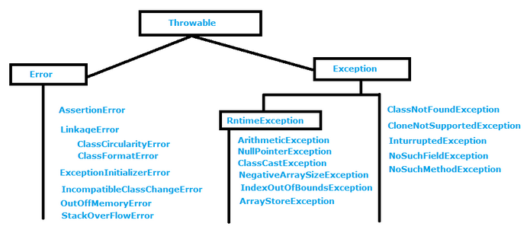
Exception hierarchy

Slide 5
Checked vs Unchecked Exception
Checked Exception
The classes that extend Throwable class except RuntimeException and Error are known as checked exceptions e.g.IOException, SQLException etc.
Checked exceptions are checked at compile-time.
Unchecked Exception
The classes that extend RuntimeException are known as unchecked exceptions e.g. ArithmeticException, NullPointerException, ArrayIndexOutOfBoundsException etc.
Unchecked exceptions are not checked at compile-time rather they are checked at runtime.

Slide 6
Keywords for exception handling in java
try
catch
throw
throws
finally.

Slide 7
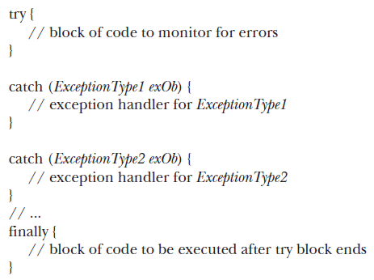
General form of exception handling block

Slide 8
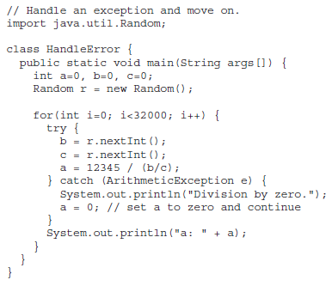
Try and Catch usage

Slide 9
Multiple catch Clauses
In some cases, more than one exception could be raised by a single piece of code.
To handle this type of situation, you can specify two or more catch clauses, each catching a different type of exception.
When an exception is thrown, each catch statement is inspected in order, and the first one whose type matches that of the exception is executed.
After one catch statement executes, the others are bypassed, and execution continues after the try / catch block.

Slide 10
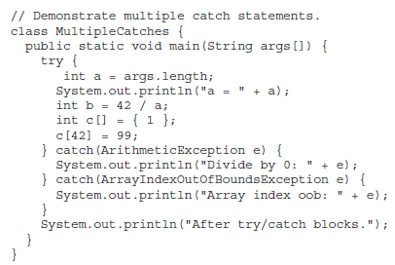
Multiple catch Clauses example

Slide 11
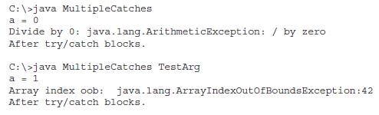
Multiple catch Clauses output

Slide 12
Thanks

